Slide 1
Online Student Orientation 2023-2024

Slide 2
Our Missions
Goodwill Industries of Southeastern Louisiana, Inc. offers opportunities to people with employment barriers to improve their economic self-sufficiency through training, education, support services and employment.
Goodwill Technical College offers quality occupational education in a supportive environment that prepares students for competitive employment.

Slide 3
Faculty, Staff & Administrators
FACULTY
James Conrad, Resident Instructor, Resident Instructor, General Education
Vanessa Sumler, Resident Instructor, Medical Billing & Coding Program
Roxanne Peacock, Lead Instructor, Medical Assistant Program
Dennis Sigur, Lead Instructor, IT Support Specialist Program
STAFF
Shaleska Julian, College Counselor/Academic Technology Support
Chelsey Melancon, Enrollment Manager
Eva Morgan, Administrative Assistant
Kristel Shelton, Student Financial Aid/Account Manager
Leslie Martin, Career Specialist
ADMINISTRATORS
Scottie LeBlanc, Vice President of Mission Services
Kiedra Williams, Chief Academic Officer

Slide 4
Student IDs
EXAMPLE
Student IDs will grant you access to the entrance at the front of the building, the pedestrian gate, and the rear access door during school hours
Student IDs should be worn while on campus

Slide 5
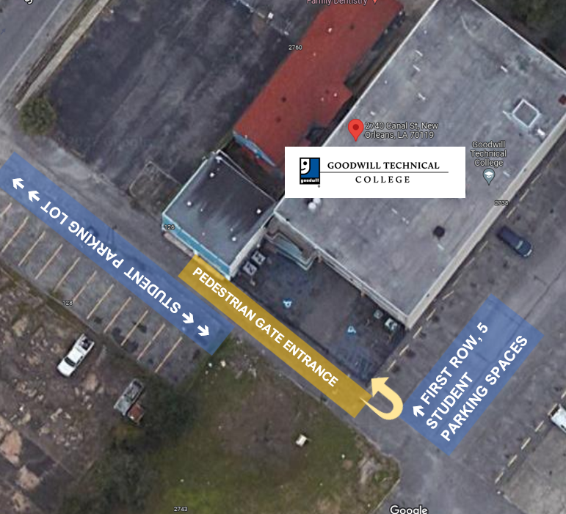
Student Parking
Student are permitted to park in 3 areas: GTC Student Parking Lot in the rear of the building, the first 5 spaces along the side of the GTC building (starting from the pedestrian gate), and the Cleveland Lot (must enter and exit from Cleveland Avenue).
Parking decals are required to park in these areas. Decals can be picked up from the administration office after completing the student parking decal form.

Slide 6
Student Parking in the Cleveland Lot
Students (must enter and exit from Cleveland Ave).
Please do not enter or exit from the parking lot.

Slide 7
Programs
Medical Billing & Coding
Medical Assistant
Hospitality
IT Support Specialist

Slide 8
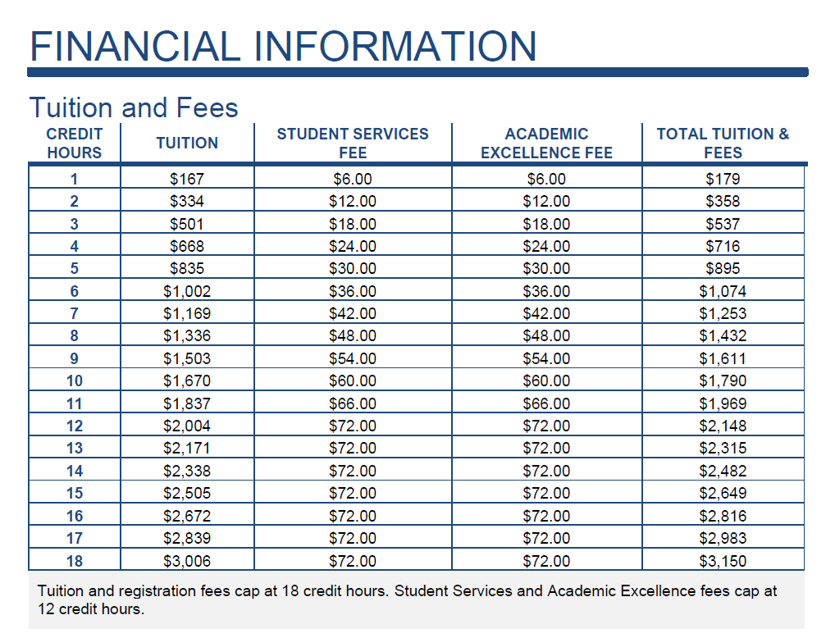
Tuition and Fees Academic Excellence Fee: The academic excellence fee promotes academic excellence at the College by enhancing institutional programs. The fee is charged at $6 per credit hour, not to exceed $72. Student Services Fee: The student services fee covers services that benefit the student and are complementary to, but not part of, instructional programs. The fee is currently charged at $6 per credit hour. Not to exceed $72 per semester.

Slide 9
Policy Overview
College Catalog

Slide 10
Academic POLICIES
Academic Calendar
Refund Policy
Drop/Add Policy
Academic Appeals
Notes:
Handout

Slide 11
Student affairs policies
Student Code of Conduct
Academic Honesty
Appearance and Attendance
Disciplinary Appeals
Student Grievance Policy
Records Policy
Career Services

Slide 12
Student Technology
Campus Café (Student Information System)
Canvas
Cengage

Slide 13
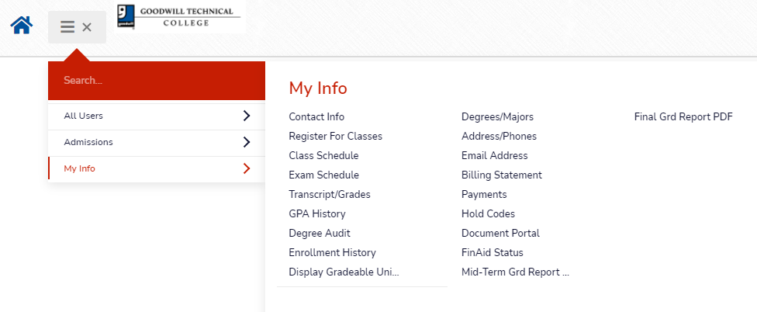
Campus Café’ (Student Information System)
Your login was provided via email when you applied to the college
Once logged into the portal you can register for classes, view class schedule, grades, fee bill, degree audit, unofficial transcript, and make payments.
Sign-in to Campus Café here: https://gwl-web.scansoftware.com/cafeweb/login

Slide 14
CANVAS
Your instructor will send a link to the email address on file inviting you to join the Canvas course you are enrolled in.
Click the link and follow the instructions.
View the video below for an overview of Canvas. Your instructor will provide more details in class.
Canvas Overview Video

Slide 15
Cengage
Cengage Unlimited allows you access to electronic textbooks used for most of your courses.
If the course you are enrolled in requires a textbook published by Cengage, the electronic textbook will be linked to your course so that you can access it.
Please note that not all courses use Cengage textbooks. If you are enrolled in a course that uses another textbook, it is your responsibility to purchase or rent the textbook you need.
Required textbooks will be posted on your instructor’s syllabus.
Goodwill Technical College Cengage Student Resources

Slide 16
Job Information Form
Goodwill Technical College captures employment information on incoming students to help Career Services assist you. Please click the link below to complete the Job Information Form if you are currently working.
Click here to complete the Job Information Form

Slide 17
Accreditation: Council On Occupational Education
Goodwill Technical College is accredited by the Commission of the Council on Occupational Education (COE). The award of accreditation status is based on an evaluation to demonstrate that the institution meets not only the standards of quality of the Commission, but also the needs of students, the community, and employers.
Why is this important? Accreditation is a status granted to an educational institution or program that has been found to meet or exceed stated criteria of educational quality and student achievement. Accreditation by COE is viewed as a nationally-honored seal of excellence for occupational education institutions such as Goodwill Technical College and ensures academic quality and integrity.

Slide 18
Next Steps
Please click the link below to complete the New Student Orientation Quiz and thank you for choosing Goodwill Technical College!
GTC New Student Orientation Quiz

